Slide 1

Research Methods 2022-2023
Kath O’Reilly
Associate Professor
Faculty of Epidemiology and Population Health
kathleen.oreilly@lshtm.ac.uk
@kathmoreilly
Thank you to Lena Lorenz
for developing this session

Slide 2
Outline of this Session (Today & Tomorrow)
TODAY
9:00-10:00 Essential ‘Principles’ of Research Methods
10:30-12:30 Applying principles in practice – Rapid Projects
TOMORROW
14:00-15:00 Drop-in sessions
15:00-16:00 Presentations and feedback
We have LG09 for this Session
Slides are here https://tinyurl.com/2p9easuz (GitHub page)

Slide 3
The “Big” Picture
1.Research Question
2. Answerable hypotheses
3. Methods for data collection
4. Actual data collection
5. Suitable analysis
6. Interpret results

Slide 4
(1/6) Research Questions
Familiarity with the subject
Establish a single primary research question at the beginning of a study
Basis of the study plan
Clear and concise
Contain the topic being studied (purpose), the variable(s), and the population
Notes:
Familiarity with the subject:
Important to know what has been studied about a topic to date (e.g. systematic literature search)
Identify gaps in knowledge/understanding

Slide 5
Three main types of questions
Descriptive – Describes an occurrence: “how much”, “how often”, or “what is the change”.
e.g. How many tsetse flies land on cloths of different colours in rural Cameroon?
Comparative – Examines the difference between two or more groups in relation to one or more variables.
e.g. What is the difference between the number of tsetse flies landing on white and black cloths in rural Cameroon?
Relational – Compares two or more variables and determines if a relationship exists.
e.g. Does the cloth colour of traps affect the number of tsetse flies caught in rural Cameroon?
e.g. http://dissertation.laerd.com/how-to-structure-quantitative-research-questions.php

Slide 6
Translating Thoughts to Research Questions
Example: “Do mosquitoes bite more humans or cattle?”
Revised: “Do female Anopheles arabiensis mosquitoes preferentially blood-feed on humans or cattle in Tanzania?”
Example: “How did the malaria burden in Nigeria change between 2010 and 2015?”
Revised: “Did national malaria control interventions cause a change in human malaria incidence and prevalence in Nigeria between 2010 and 2015?”

Slide 7
Brainstorming
Good practices of formulating research questions
Basic question to answer
Achievable & answerable in frame of research
Know your methods and analysis before formulating question
Avoid repetition of info already out there
Where, when and why?
Focus on one issue only
Clear, precise, specific; should not leave room for ambiguity
Narrow scope (but not too narrow; it shouldn't be answerable with a single statistic)
“So what?” – has impact

Slide 8
P&P: Take a pen and paper…
Once you’ve done a little brain-storming please place here…
3 Word Project

Slide 9
P&P: Research Question
Start translating your “3 words” into a Research Question…
Consider:
Basic question to answer
Achievable & answerable in frame of research
Know your methods and analysis before formulating question
Avoid repetition of info already out there
Where, when and why?
Focus on one issue only
Clear, precise, specific; should not leave room for ambiguity
Narrow scope (but not too narrow; it shouldn't be answerable with a single statistic)
“So what?” – has impact

Slide 10
2. Hypothesis Testing

Slide 11
Hypotheses
Refinement of the research question into a testable prediction
Hypotheses are not always appropriate – e.g. when studies are more descriptive or explorative with no clear expectations or defined variables
Clear statement of what is intended to be investigated – formalise relationship between variables
Must be specified before research is conducted

Slide 12
Cont.
Example: “Tsetse flies are attracted to a certain colour”
Revised: “Tsetse flies are more likely to land and rest on black cloth than on cloth of other colours”
Example: “Rain affects malaria burden”
Revised: “Higher rainfall increases the number of people testing positive for malaria with RDTs and microscopy”

Slide 13
Feedback & brainstorming
Good practices of formulating hypotheses
It’s a statement - it’s not a question
Define variables – how they are quantified
Mirror the research question
Neither too specific nor too general
It’s a prediction of consequences
Considered valuable even if proven false

Slide 14
Hypothesis testing
Hypothesis (or significance) testing
The purpose of hypothesis testing is to make an inference about the population of interest on the basis of a random sample taken from that population.

Slide 15
Defining the Null Hypothesis
Null hypothesis (H₀) = There is no effect in the population Example: “There is no effect of cloth colour on tsetse fly landing.”
Alternative hypothesis (H_{A}) = H_{A} formulated more specifically according to study objectives/theory
“Cloth colour has an effect on tsetse fly landing.”
The final conclusion is always given in terms of the null hypothesis:
e.g. 'reject H₀ in favour of H_{A} ' or 'do not reject H₀ '
Notes:
There are no black swans. – If one black swan is spotted, reject null hypothesis. Not always that simple.

Slide 16
5 steps in hypothesis testing
Define the null and alternative hypotheses of the study;
Collect data from a sample of individuals;
Calculate the value of the test statistic specific to the null hypothesis and the data;
Compare the value of the test statistic to values from a known probability distribution;
Interpret the P-value and results.

Slide 17
‘Errors’ in Hypothesis Testing
Type I Error: We reject the null hypothesis when it is true. Denoted by α (significance level of the test). Reject H₀ if P < α.
For example: A type I error would occur if we concluded that the two drugs produced different effects when in fact there was no difference between them.
Type II Error: We do not reject the null hypothesis when it is false. Denoted by β. (1- β) is the power of the test.
For example: A type II error would occur if it were concluded that the two drugs produced the same effect when in fact they produced different ones.

Slide 18
Decision
 | Reject H₀ | Don't reject H₀
H₀ true | Type I Error | No error
H_{A} true | No error | Type II Error
Reality
Important to have studies that are adequately powered
Power = Probability of detecting a real treatment effect given it exists
Choice of α level and power based on a consideration of the relative costs of type I and type II errors.
Choosing the correct sample size is important

Slide 19
P&P: Generate a Hypothesis Test
Consider how you would translate your Research Question into a testable hypothesis

Slide 20
3. Methods for Data Collection

Slide 21

Defining your variables
What is your outcome (dependent) variable?
What is/are your exposure (independent; explanatory) variable/s?
What is your unit of observation? Determines scale of replication.
Mosquitoes, traps, houses, villages...
What is your study population?
How generalisable will your data be?

Slide 22
Exposure variables
Danger of including a large number of explanatory variables
Common sense: Biological or clinical reasons to suspect relationship
Univariable and multivariable analyses
Interactions between explanatory variables (e.g. factorial experiments)
Collinearity: 2 explanatory variables are highly correlated → difficult to evaluate their individual effects in multivariable models
Confounding: 2 explanatory variables are both related to the outcome and to each other → failure to adjust may lead to biased estimates of model parameters
➔ Think carefully which factors to measure and include in study design, analysis and how to interpret results
Notes:
Rule of thumb: at least 10x as many units as explanatory variables in linear regression models.
Eliminate some variables by performing a univariable analysis (p value of 0.10 instead of 0.05) for each explanatory variable to assess whether it is likely to be related to outcome variable. We then only consider variables that were significant at the first stage in the multivariable model.
Interactions: when relationship between one of the explanatory variables and the outcome is not the same for different levels of the other explanatory variable. i.e. the 2 explanatory variables do not act independently on the outcome variable. Interaction terms only be included after main effects. Statistical tests of interactions usually of low power.
Collinearity: 2 variables may be sign associated with outcome in univariable analysis but not in the multivariable analysis. It’s detected by examining correlation coefficients between each pair of explanatory variables. Of concern when coefficient is greater than 0.8 (+ or -). Easiest solution when collinearity is detected is to include only one of the variables in the model.
Confounding: e.g. relationship between heart disease and smoking in middle-aged men. Alcohol is also associated with heart disease and smoking and alcohol consumption are correlated. Unless adjusted, the effect of alcohol consumption may confound the relationship between smoking and heart disease.
Ways to deal with confounding:
Create sub-groups at level of confounder (e.g. group of drinkers and non-drinkers) and analyse correlation for sub-groups separately. (Smaller sub-groups = lower power; problems with multiple testing)
Match paired of individuals on all confounding variables (that differ in exposure of interest) and perform paired analysis (Difficult to identify exact matches and reduces power)
Adjust for each confounding variable by including it as an explanatory variable in a multivariable regression model
Propensity score approach

Slide 23
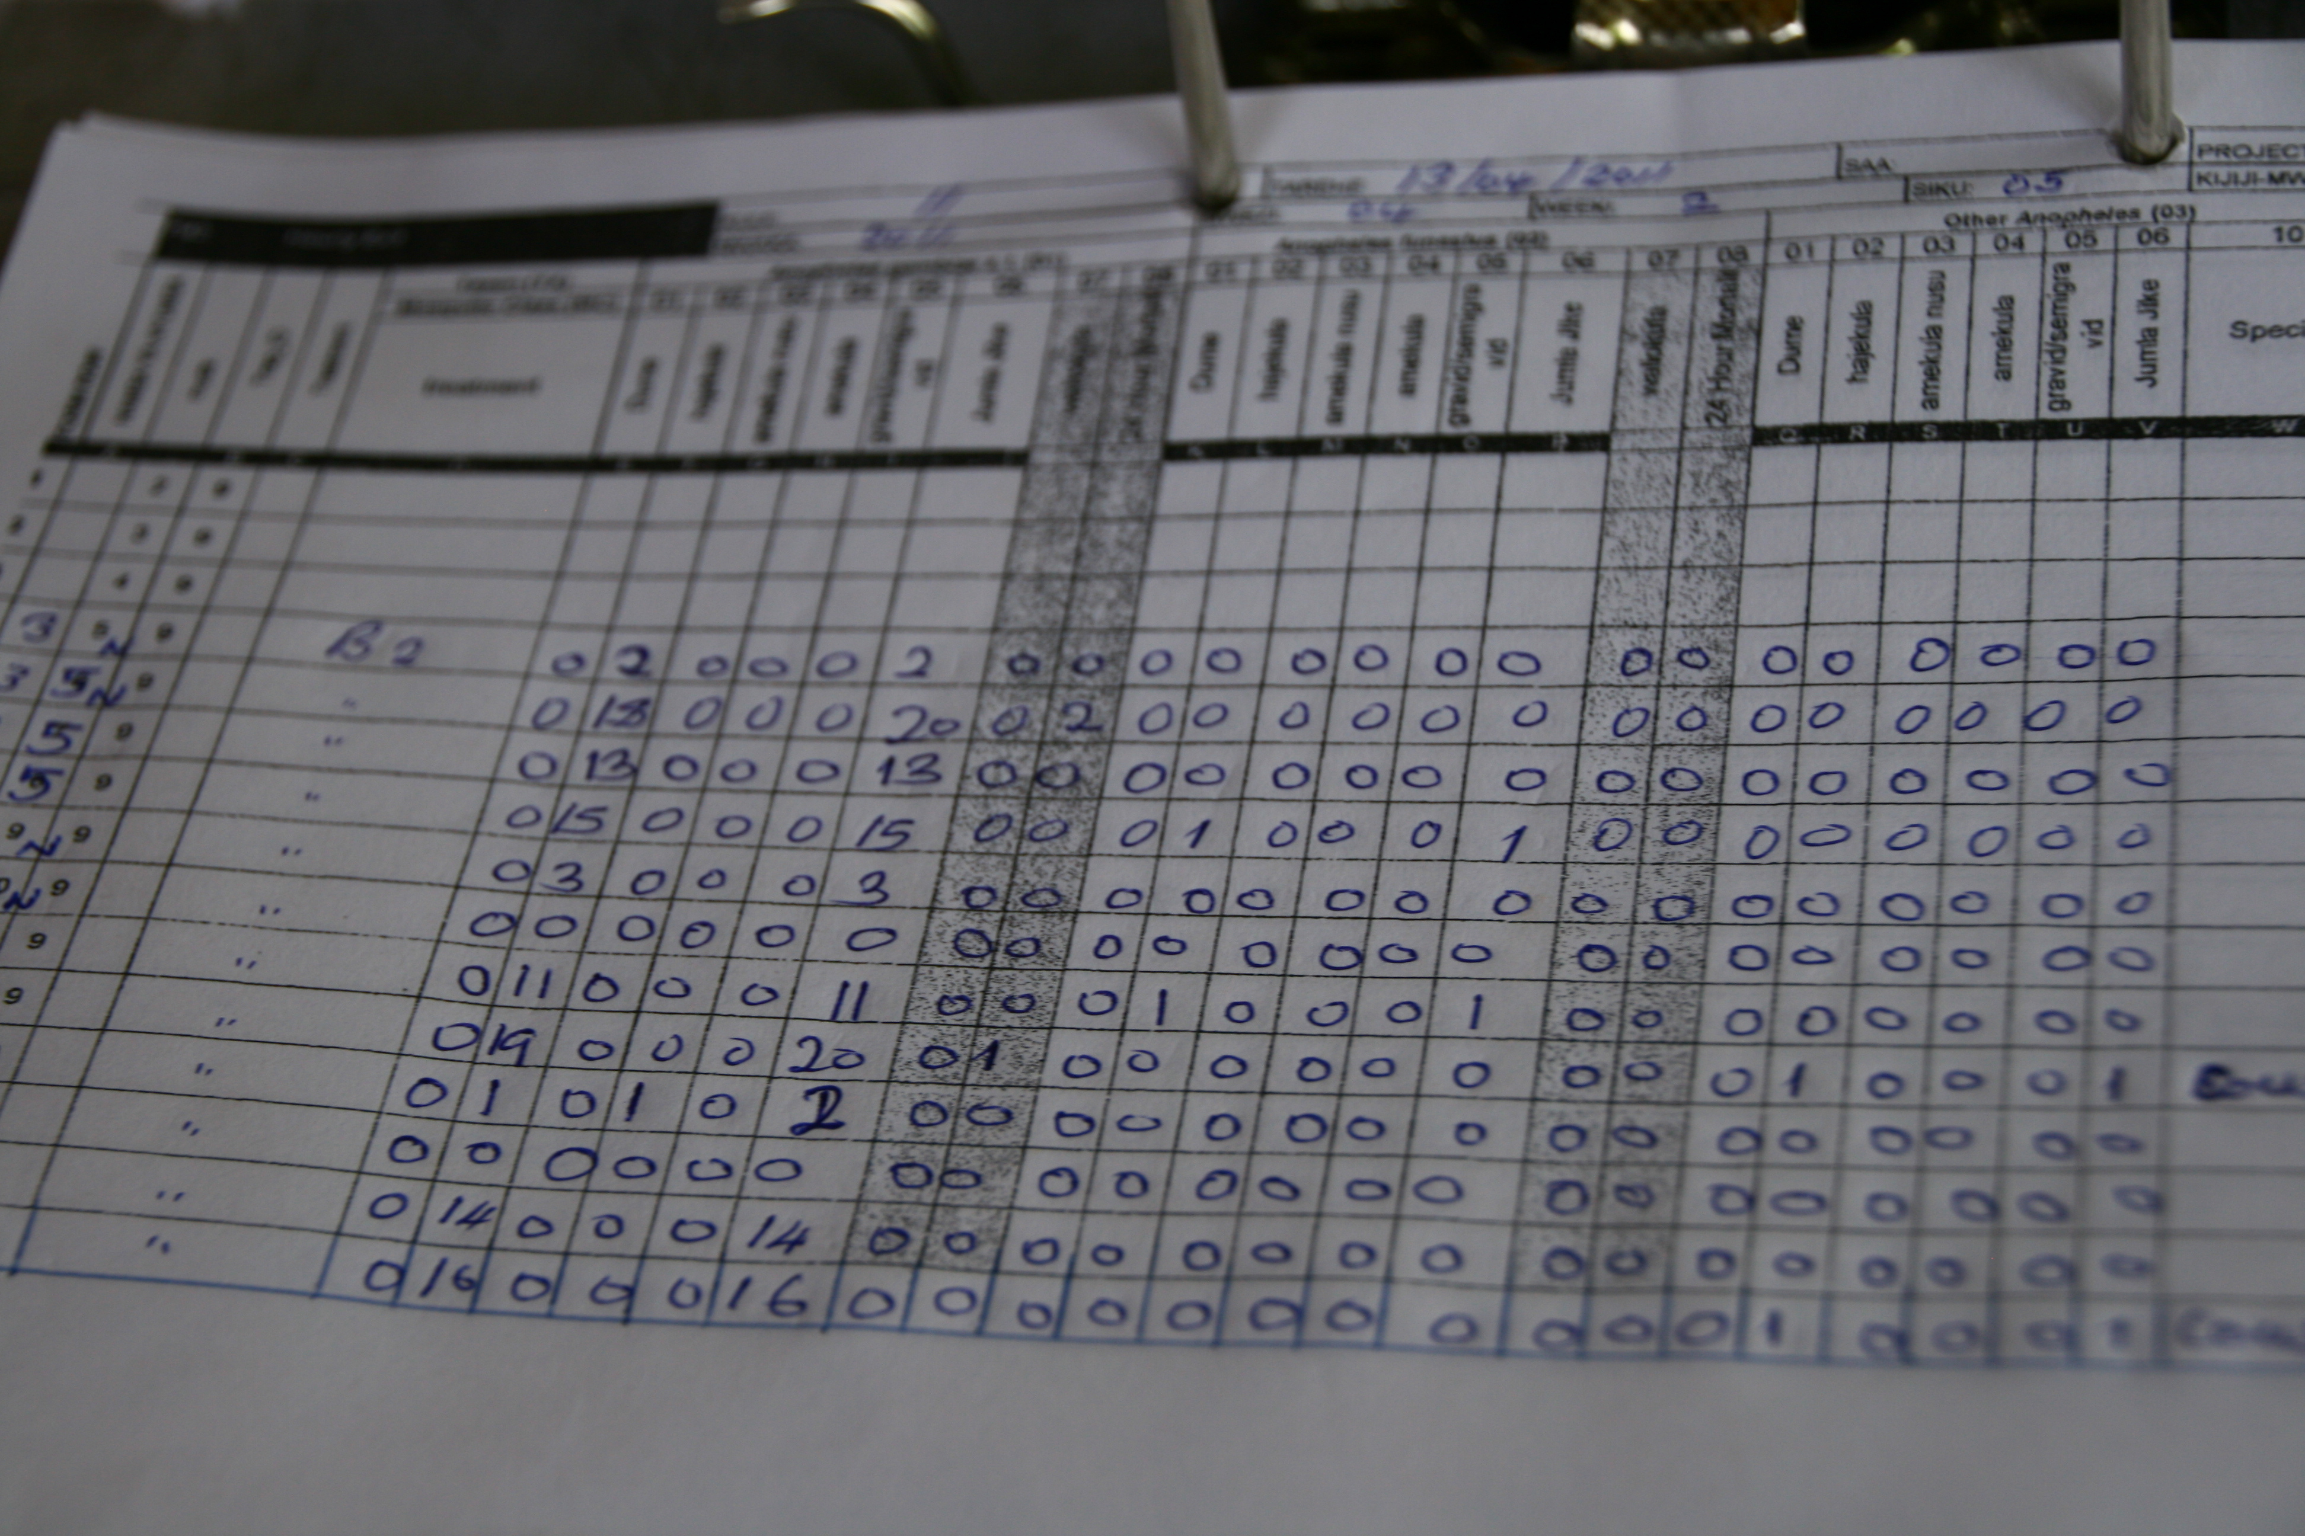
Anticipate the future
Create a dummy dataset with your defined variables
How can you analyse it?
What will be the result?
Does this actually answer your hypothesis?
Will it have sufficient power?

Slide 24
Experimental design: Causality
We are often most interested in causality, but many experimental designs only illustrate association…
Does exposure to a factor cause the outcome?
Ecological studies (more later) will illustrate association
Laboratory experiments and RCTs are gold standard (more later)
Some rules for determining causality (Hill 1965):
Cause must precede effect
Association should be biologically sensible
Consistent results from a number of studies
Strong association between cause and effect
Dose-response relationship with effect
Removing factor of interest should reduce risk of disease
Beware of spurious correlations…

Slide 25
Experimental design: Controls
What would have happened in the absence of intervention?
Observational: compare units that happened to be “treated” with those that were not treated
Experiment: compare units assigned to “control” with “treatment” conditions
Negative control: No effect when there should be no effect
Positive control: A known outcome is expected (gold standard)

Slide 26
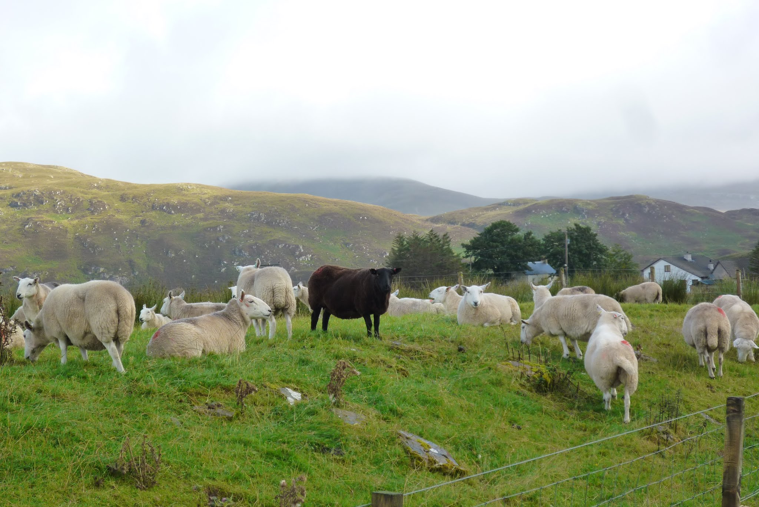
Experimental design: Replication
Everything varies!
Variation can affect your outcome variable, and design needs to account for natural variability
Replication increases your power to detect important differences
Not enough replication increases uncertainty around your estimates
Notes:
Variation caused by biological factors or measurement errors or unexplained random variation. Measure impact of variation in data by standard error. When measurement of a variable is subject to considerable variation, estimates will be imprecise with large SEs. Desirable to reduce impact of variation as much as possible, thereby increasing the precision of our estimates.
Replication must be at the right scale – needs to be at the scale of the experimental manipulation. 2 plots of land, one that flooded and one that didn’t flood – no matter how many insect traps you employ within each of the two areas, the spatial unit of replication is the “area” as there may be inherent differences between the two areas in addition to the flooding that may affect insect numbers.

Slide 27
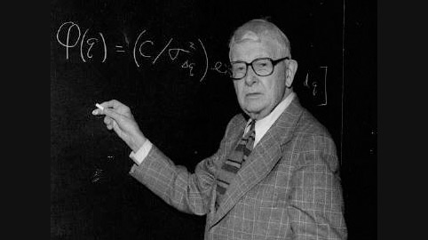
Experimental design: Sample size
We need to expand upon the ‘how many?’ question
Balance between study precision/power and logistical feasibility
Based on random variation in population (i.e. use of standard deviation)
Specify H_{A} or effect size to be detected
Usually focus on primary outcome
Sample size calculator:
EpiTools
Notes:
Sample size calculations to determine how much replication is necessary. Alternatively, fixed replication due to external factors, so calculations to be used to determine the effect size we can confidently identify with the sample.
Statistical power is a measure of our confidence that we would have detected an important effect if one existed.
Effect size = how big a change is of interest. We are more likely to detect large effects.

Slide 28
Experimental Design: Bias
Systematic difference between results from a study and reality
Bias can crop up everywhere: study design, analysis, publication…
Overestimate correlations/effect sizes; hide real associations
Selection/sampling bias – study units not representative of study population
Information bias – systematic errors in measurements of exposure or outcomes
E.g. recall bias, measurement bias, application bias
Notes:
p. 102 in purple book for many e.g.s for selection and information bias
Recall bias, subjects asked for disease or exposure histories in cross-sectional or case-control studies
Measurement bias, systematic wrong recording of lab measurements due to wrong calibration of equipment or rounding errors
Application bias, treatments provided/questions administered in different ways (e.g. lab: exposure on day 1, control on day 2; multi-centre trials different methodologies… )
There is also funding bias and publication bias

Slide 29
Randomisation
Random sampling: All subjects are equally likely to be selected. Avoids sampling bias.
Random allocation: Every subject has an equal opportunity to be allocated to the treatment/control groups.
Blinding
Study participants, researchers (double blind), statisticians...
do not know “control” vs “treatment” allocation

Slide 30
P&P: Tangible elements of the study
Consider the details you have written so far…
What is the outcome you will measure?
What other aspects will you need to measure?
How long will the study need to happen for?
How much data needs to be collected? When will ‘enough’ be collected?

Slide 31
3. Methods for Data Collection –
study types

Slide 32
Cross-sectional studies
Describe frequency and characteristics of an outcome at single point in time
Measure disease prevalence but not incidence – cannot observe trends
Relationship between exposure and outcome non-directional
Cheap and quick; easy to standardise
Useful as preliminary studies to formulate hypotheses for intervention studies/trials
Survey or census, e.g. Malaria Indicator Surveys

Slide 33
Case-Control studies
Retrospective: Compare a group of individuals with outcome of interest (=cases) with a group that do not have it (=controls)
Compare exposures to (risk) factors in the past to explain outcome of interest, measured by odds of outcome (calculate odds ratios; ORs)
Selection bias – have precise and unambiguous eligibility criteria
Matching of cases and controls
Recall bias
Cheap, quick, easy
Notes:
Retrospective study: Compare a group of individuals with outcome of interest (=cases) with a group that do not have it (=controls)
Compare exposures to (risk) factors in the past to explain outcome of interest, measured by odds of outcome (calculate odds ratios (ORs))
Eligibility criteria for cases and controls must be precise and unambiguous – avoid bias in selection of participants
Matching of cases and controls by e.g. gender + age but not potential risk factors or those that may fall on the causal pathway [and remember that any variables used for matching can then not be identified as a potential risk factor for outcome]
Important to define risk factors before study and take care to measure all known factors associated with the outcome
Be aware of recall bias by patients (differential ability to remember histories)
Cheap, quick, easy, suitable for rare diseases where cases can be accumulated over time but not suitable when exposures to risk factors are rare
THINK OF EXAMPLES

Slide 34
Ecological/correlation studies
Associations between outcome and exposures at population level
Examine exposure-disease relationship between groups at one time point
Examine exposure-disease relationships over time in one group (time trends)
Useful to explore hypotheses; quick and cheap
Overestimate degree of association between variables
Does not prove cause-effect relationships
Notes:
Measurements that represent characteristics of whole population used to describe associations between outcome and exposures, measured by correlations
Unit of analysis is population not the individual
Examine exposure-disease relationship between groups at one time point
Examine exposure-disease relationships over time in one group (time trends)
Useful to explore potential hypotheses; exploratory as quick and cheap
Overestimate degree of association between variables as individuals exposed are not necessarily individuals who get disease (as everything is measured at the population level)
Does not prove cause-effect relationships
For example, male circumcision and HIV seroprevalence
THINK OF MORE RELEVANT EXAMPLES FOR THIS

Slide 35
Cohort studies
Prospective: Follow group of individuals over time to investigate how exposures affect outcome of interest
Outcome = estimate of incidence of disease or change in variable over time measured by risk of disease, which allows calculation of relative risk (RR)
Cohort should be representative of relevant population
Expensive; time consuming (long-term); not suitable for rare outcomes but good for rare exposures
Risk of loss to follow up (take into account when calculating sample sizes)
Low risk of recall or selection bias
Notes:
Prospective: Follow group of individuals over time to investigate how exposures affect outcome of interest – measure each subject 2 or more times on the same characteristic [select individuals based on their known exposure]
Look at effect of suspected risk factors that cannot be controlled experimentally
Outcome = estimate of incidence of disease or change in variable over time measured by risk of disease, which allows calculation of relative risk (RR)
Cohort should be representative of population to which results are going to be generalised
Ideally, participants should be disease-free at recruitment
Expensive; time consuming (long-term); not suitable for rare outcomes but good for rare exposures
Risk of loss to follow up (take into account when calculating sample sizes)
Low risk of recall or selection bias
THINK OF EXAMPLES

Slide 36
Laboratory experiments
Animal studies; molecular studies; model systems
Manipulate variables of interest
Controlled conditions, exclude as much unexplained variation as possible
Environmental conditions
Physiological status of subjects
Genetic factors of subjects
Look out effect of exposures in isolation – reductionist?
Simplify the natural world – generalisable?

Slide 37
Factorial experiments
Simultaneous analysis of any number of factors of interest
2x2 factorial experiment: 2 factors each at 2 levels
Test whether 2 factors are interactive, i.e. whether the effect of net treatment is different whether insecticide has been sprayed or not
 | Untreated Net | ITN
No spraying
IRS
Notes:
An interaction would suggest that the combination of insecticide-treated net and IRS together is more (or less) effective than would be expected by simply adding the separate effects of each treatment
OTHER EXAMPLES

Slide 38
Randomised Control Trials
Exposure randomly allocated to subjects
Measurements of outcomes: cross-sectional or longitudinal
Avoid allocation bias
Provide strong evidence of cause-effect relationships
Expensive and difficult to design; ethical issues
External validity – are results valid outside of experimental setting?

Slide 39
Smoking and Cancer
In the 1940s the UK had the highest lung cancer rates, and incidence exceeded tuberculosis for the first time…
Motor cars? Smoking?
1948
Richard Doll and Austin Bradford Hill began a case-control study of cancer in London hospitals and interviewed patients about daily habits
1949
Richard Doll stopped smoking
1950
“Smoking and Carcinoma of the Lung” BMJ – smoking assoc. x16 risk
1954
Doll and Hill: “The Mortality of Doctors in Relation to Their Smoking Habits” BMJ
A cohort study of doctors where they were followed until death
A dose response relationship with lung cancer and increased risk of heart disease

Slide 40
The “Big” Picture
1.Research Question
2. Answerable hypotheses
3. Methods for data collection
4. Actual data collection
5. Suitable analysis
6. Interpret results

Slide 41
P&P: Study design
Does your study fit a specific study design?

Slide 42
Rapid Project
Reconvene at 10:30
Come back with:
A research Q you could do over the summer (…think feasible!)
The hypothesis
The (rough) methods
Online discussion of ideas…we will then coalesce towards 4 ideas and form groups to develop further
Plan your Research
Present your Research and give feedback to other groups

Slide 43
Recommended reading
A Short Introduction to Epidemiology by Neil Pearce (LSHTM), online eg here
Medical statistics 2nd edition by Betty R Kirkwood & Jonathan A.C. Sterne (library and online)
Medical Statistics at a Glance 3rd edition by Aviva Petrie & Caroline Sabin (library)
Great for (simple) sample size calculations:
EpiTools (http://epitools.ausvet.com.au)

